Slide 1
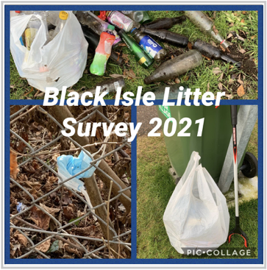
Black Isle Litter Survey 2021:
The Results
Responses: 378

Slide 2
1. In which community council area do you live?
Answered: 375

Slide 3
2. What is your age?
Answered: 377

Slide 4
3. How concerned are you with the amount of litter in your local community?
Answered: 378

Slide 5
4. Is there a specific type of litter that appears in your community?

Slide 6
4. Is there a specific type of litter that appears in your community?

Slide 7
5. What factors do you think contribute most to litter in your area?
Answered: 378

Slide 8
6. What consequences do you associate with large amounts of litter?
Answered: 377

Slide 9
7. Is there an area in your local community that would benefit from volunteer litter picking?
Answered: 351

Slide 10
8. Do you think the Black Isle would benefit from more recycling facilities?
Answered: 364

Slide 11
9. Would you be happy to pay a little extra for takeaway food and drinks, to support the use of environmentally friendly packaging?
Answered: 371

